Slide 1
A Request-level Guaranteed Delivery Advertising Planning:
Forecasting and Allocation
ADVISOR: JIA-LING KOH
PRESENTER: CHENG-WEI CHEN
SOURCE: KDD’20
DATE: 2021/8/23

Slide 2
Outline
Introduction
Method
Experiment
Conclusion

Slide 3
Outline
Introduction
Problem
Previous Work
Target

Slide 4
Introduction-Problem
Publisher
Optimal allocation
User
Historical
requests
Contracts
Demand
Advertiser
Funds

Slide 5
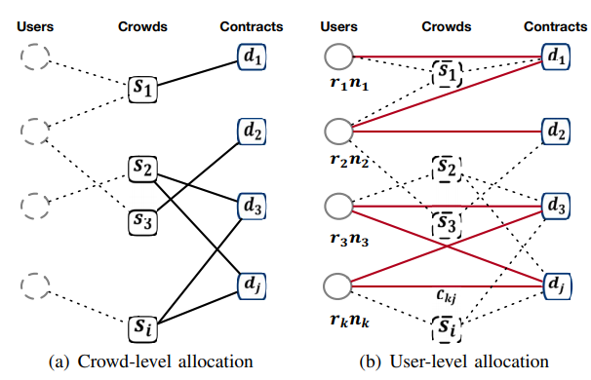
Previous work
1) Advertisers pursue more precise targeting, which requires not only user-level attributes but also request-level attributes
2) Users prefer more friendly ad serving, which imposes more diverse serving constraints

Slide 6
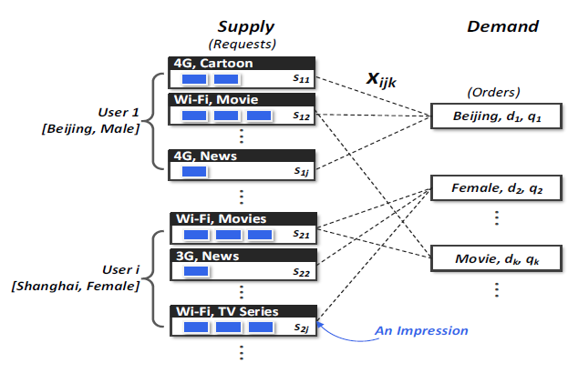
Target
User attribute:
[ platform, area, age, gender]
Ex: 48y/o, iPhone female user from Shanghai
Request attribute:
[ type, content name, network, target time (48 options, every half an hour is an option), etc]
Ex: Movie, Spider man, Wi-fi, 36
Input
(Contracts)

Slide 7
Target
Input
Demand attribute:
[ target impression, amount of impression, constraints(reach and frequency)]
Output
(Contracts)

Slide 8
Outline
Method
Architecture
Method detail

Slide 9
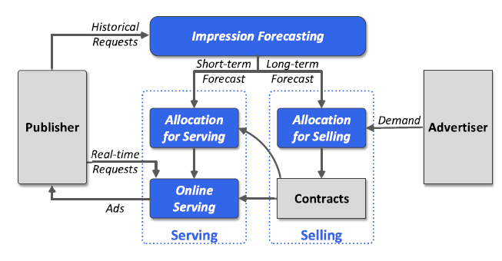
Architecture
1
2

Slide 10
Impression Forecasting
Sets of indices of user i and
request type j respectively
Dt = ( |i ∈ I , j ∈ J )
Given the historical N-day inventory
D1, D2, · · · , DN
Predict the future M-day inventory
D′N+1, D′N+2, · · ·, D′N+M

Slide 11
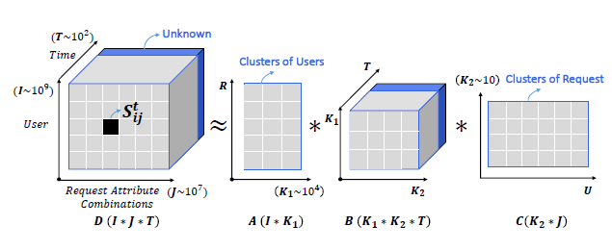
Impression Forecasting
D′N+1
D(i*j)
One cluster of user
One cluster of request
A matrix K1*K2 in one day
(Respectively show the matrix of each day)

Slide 12
Impression Forecasting
add D′N+1
D′N+2
D(i*j)
One cluster of user
One cluster of request
A matrix K1*K2 in one day
(Respectively show the matrix of each day)

Slide 13
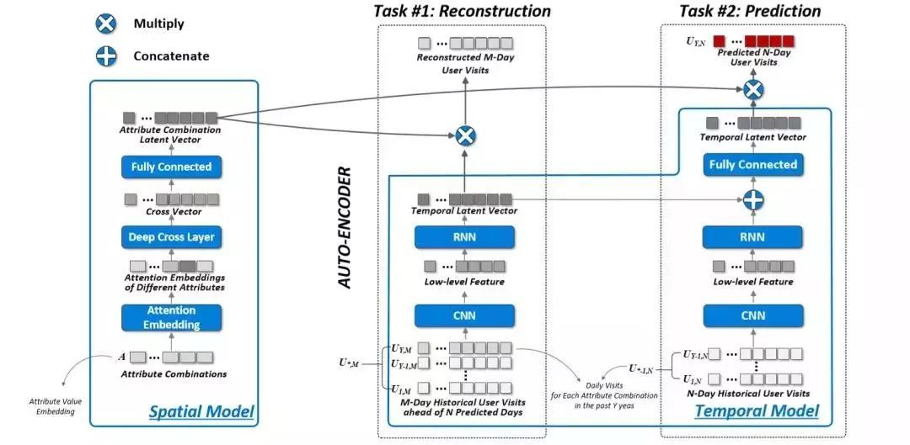
Impression Forecasting
For one user in one request
Related work: ST-TF[10]
User & Request attribute
User historical requests
Notes:
左邊是clustering of users & request的向量去找相對重要程度(大圖的左右向量)
右邊是透過歷史紀錄去學相對重要程度

Slide 14
Impression Forecasting
Loss function before clustering of users & requests

Slide 15
Impression Forecasting
Loss function after clustering of users & requests
Reweight for
target attribute
Target user and request attribute
combinations determined by contracts
Users clustering
Requests
clustering
Center vector of cluster c
Users’ daily impression vector
Notes:
Users’ daily impression vector就是每個user看cluster c 的紀錄，累積很多天串成vecter， uc是平均，這樣可以知道對request的分類是否平均

Slide 16
Architecture
2

Slide 17
Impression allocation: Input & output
Input
Input:
sij: Total impression for user i in j type
Vk: Relative priority of contract k
dk: Advertiser requests amount of impression
qk: Constraint(reach & frequency)
Output:
xijk: Optimal allocation impression sij to contract k
Output
(Contracts)

Slide 18
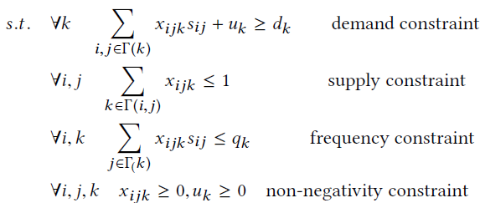
Impression allocation
Neighborhood of demand node k
Penalty for uk
<Notation list>
Vk: Relative priority of contrack k
sij: Total impression for user i in j type
dk: Advertiser requests amount of impression
uk: Underdelivery impression
xijk: Optimal allocation impression sij to contract k
Notes:
thita K 為預期投放率
sij是為了跟後面的比例相乘得到總投放數量

Slide 19
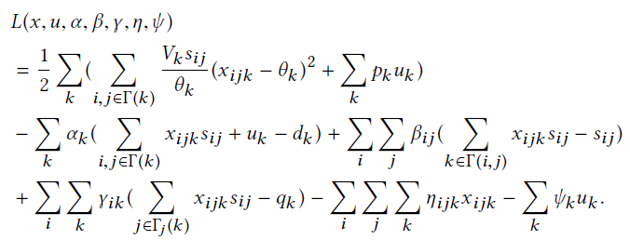
Optimization algorithm
min f(xijk)
demand constraint
supply constraint
frequency constraint
non-negativity constraint

Slide 20
Allocation for selling
sij assigned to new demand yij

Slide 21
Allocation for serving
weight for contract k
click through rate for contract k

Slide 22
Outline
Introduction
Method
Experiment
Conclusion

Slide 23
Dataset
Tencent online video site
from June 1, 2018 to Dec 31, 2019
 | Impressions | Contracts
Allocation for selling | 650,223 | 5,753
Allocation for serving(large) | 726,390 | 5,782
Allocation for serving(small) | 9,087 | 104

Slide 24
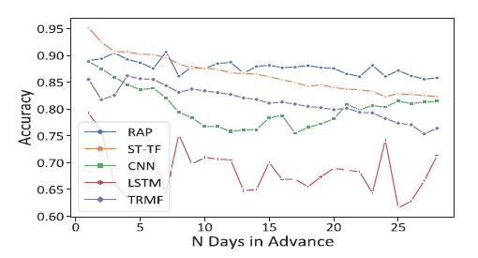
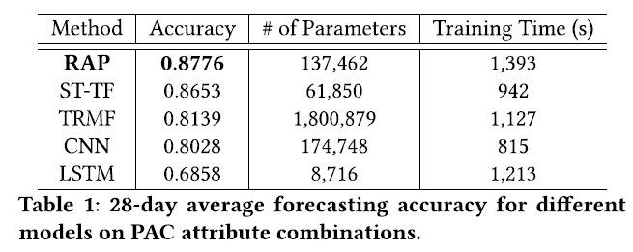
Forecasting accuracy

Slide 25
Experiment: Allocation
Crowded-level
Users-level

Slide 26
Experiment: Allocation

Slide 27
Experiment: Allocation

Slide 28
Outline
Introduction
Method
Experiment
Conclusion

Slide 29
Conclusion
We present a holistic design of a large-scale guaranteed delivery advertising planning system, which supports efficient request-level impression forecasting and allocation.
Our system empowers advertisers to achieve sufficiently precise targeting while keeping high delivery rate and play rate, which can significantly increase the publisher revenue and return on investment of advertisers.
It can also provide more user-friendly ad serving with the ability to handle a set of customized linear serving constraints.

